Slide 1
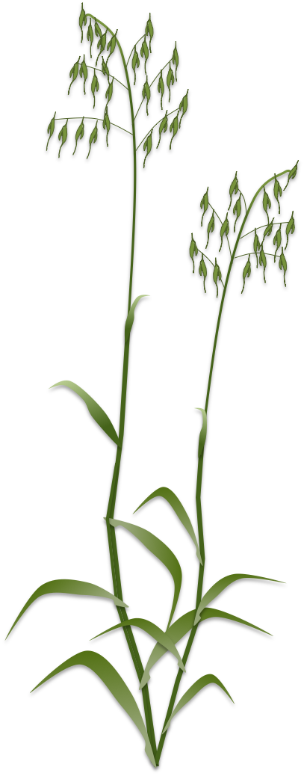

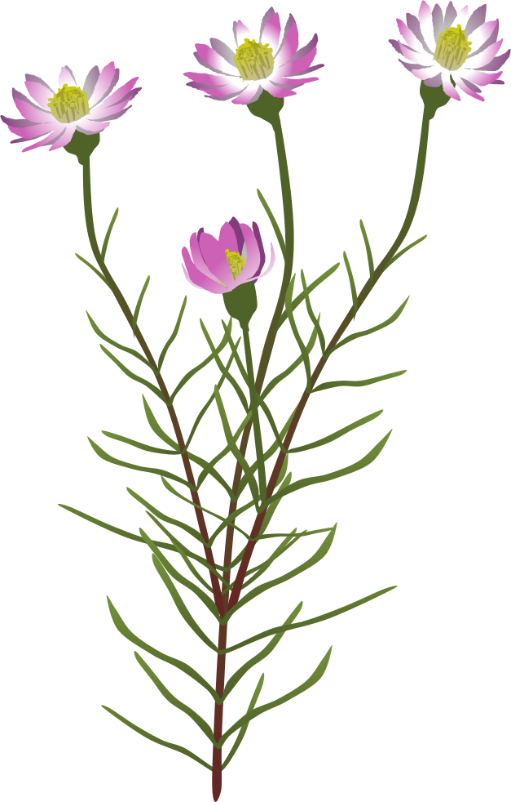
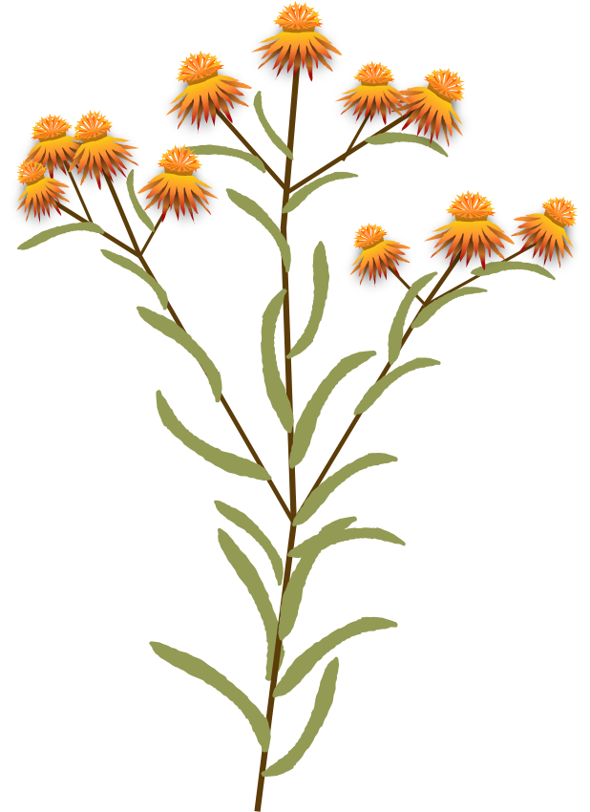



= Primary Key
Functional Traits
Database Schema
Projects
project_id | researcher | email | study_site
1 | Chrissy elmer | c.elmer | WA
Traits
Field_season_id | traits
1 | SLA, LA
Field Season
field_season_id | project_id | year | crew_list
1 | 1 | 2017 | Trace, Cath
site
Site_id | site | area | lat | long | Max_temp | Min_temp | Ann_precip
1 | bendering
2 | Kunjin
3 | Perenjori
4 | bowgada
5 | Korrigin
Plot
plot_id | field_season_id | Site | block | treatment
1 | 1 | 2 | 1 | 1
2 | 1 | 3 | 1 | 2
 |  |  | 2
Treatment
Treatment_id | treatment
1 | control
2 | water
3 | Shade
4 | Density_30
5 | Density_60
6 | edge
Invasive
Invasive_id | invasive
1 | exotic
2 | native
Habit
Habit_id | habit
1 | grass
2 | forb
Life form
Life_Form_id | habit
1 | annual
2 | biannual
3 | Perennial
Soil moisture
Soil_moisture_ID | Plot_id | value | units | Date collected
1 | 1 | 33 | %
2 | 1 | 21 | %
3 | 2
Soil moisture,
Soil NPK,
pH,
% dirt ground,
% canopy cover,
% woody cover,
Soil WHC
Etc.
individual
Indv_id | Plot_id | Species_id
1 | 1 | 1
2
3
Species
Species_id | Family | Genus | Species | Invasive | Habit | Life form
1 | Asteraceae | Arctotheca | calendula | 1 | 2 | 1
2
3
SLA
SLA_ID | Indv_id | value | units | Date collected
1 | 1 | 23 | g/cm^2
2 | 1 | 22
3 | 1 | 34
Competitor
Neighbourhood_id | Plot_id | Focal_indv_ID | Competitor_indv_ID | Distance
1 | 1 | 3 | 2 | 7
1 | 1 | 3 | 43
3
SLA,
Leaf area,
Leaf weight,
Height,
Above_Biomass,
Fecundity,
No. flowers,
No. leaves,
H:W,
Seed mass
Etc.
Neighbourhood
Neighbourhood_id | Length | Shape | Units
1 | 30 | circle | cm
2
3

